Slide 1
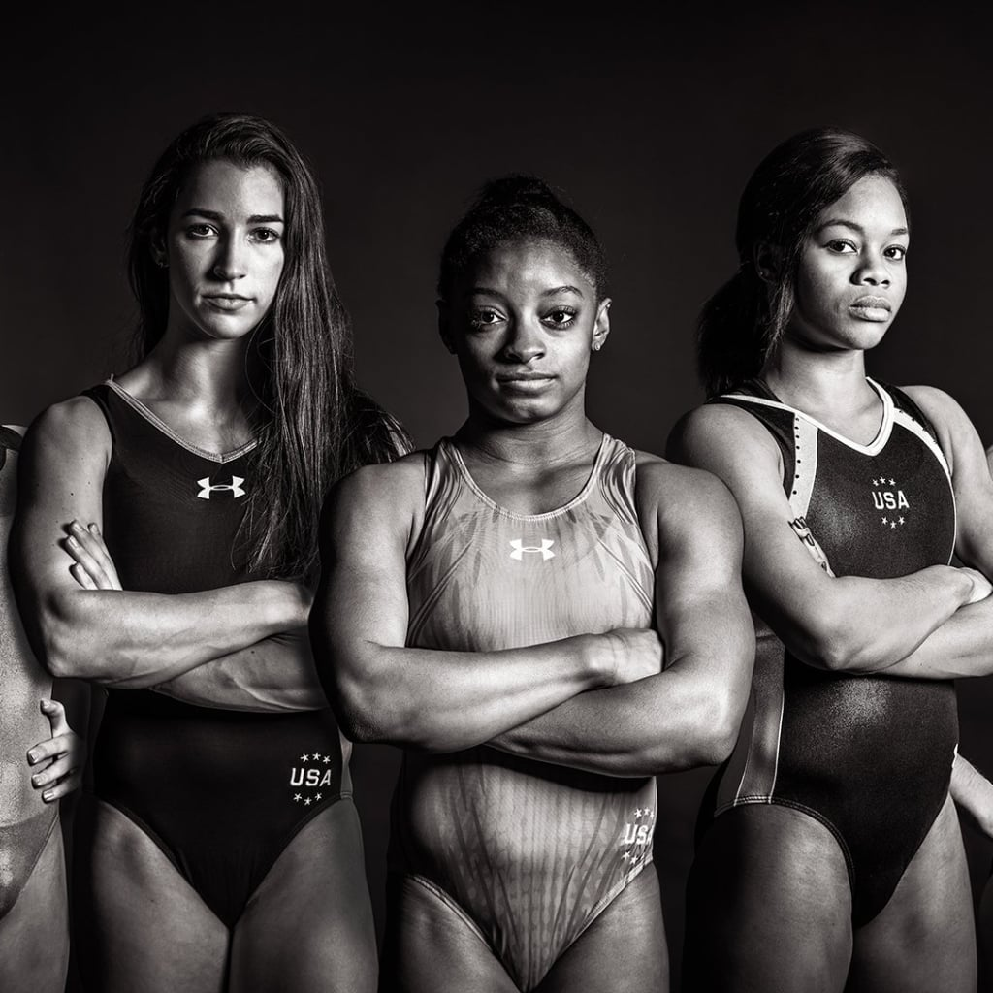
Women & the Olympic Games
By Alexander Espinosa, Ashley Lutz, Celenia Chapa, Felecia Helms, and Tyler Cutrer

Slide 2





Git Sum
Alex Espinosa
Tyler Cutrer
Celenia Chapa
Ashley Lutz
Felecia Helms

Slide 3
Data
Huge Kaggle Data Set
US, Japan, Russia and China
Gymnastics, Track & Field, Swimming

Slide 4
Questions
Did Women’s participation in the Olympic Games change over the years?
Which sports had the biggest increase in Women participation in relation to the women’s movement?
What is the average age of a Female Olympian and does this average age change depending on country?
Did world events affect the performance of Olympic Athletes?

Slide 5
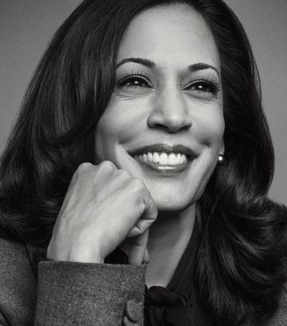
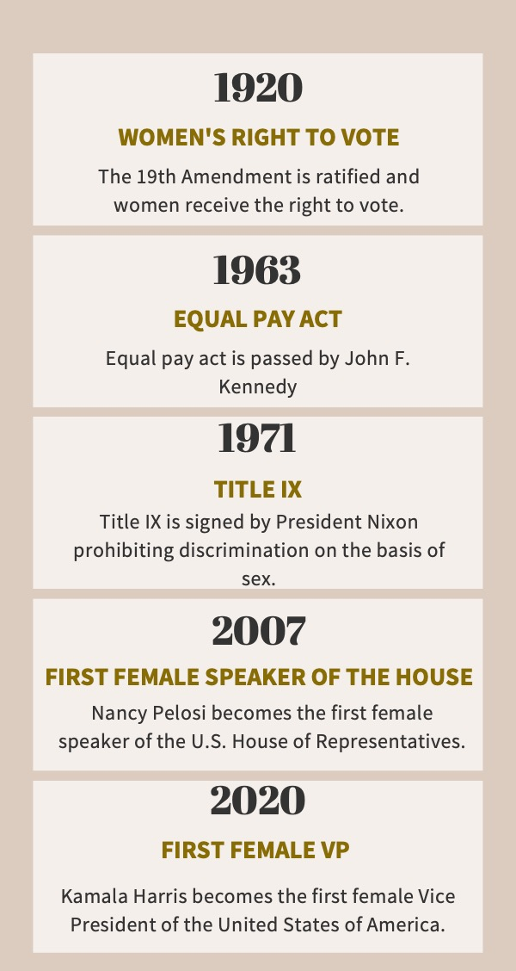
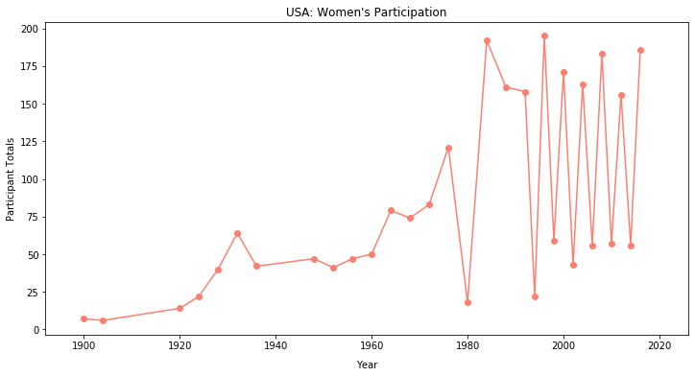
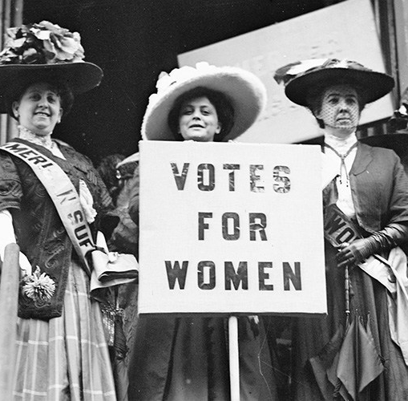
Women’s Suffrage

Slide 6
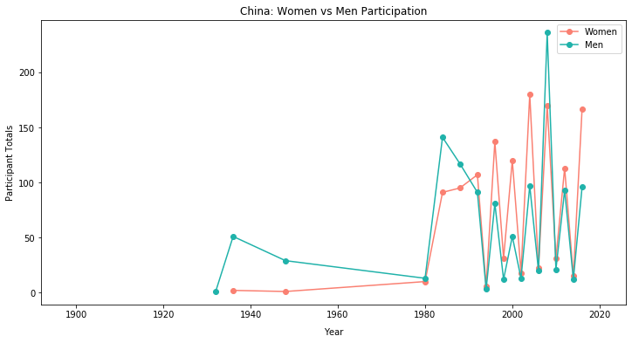
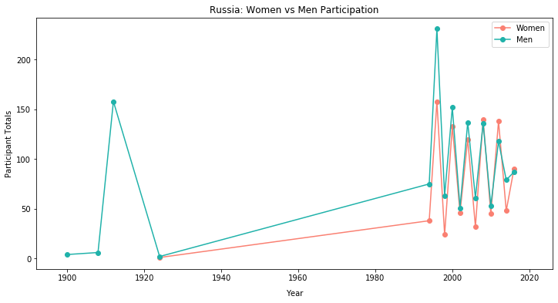
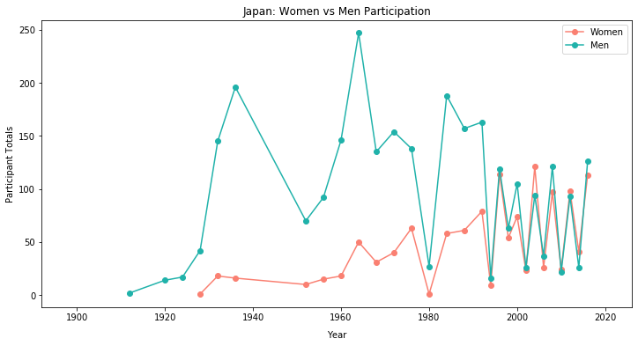
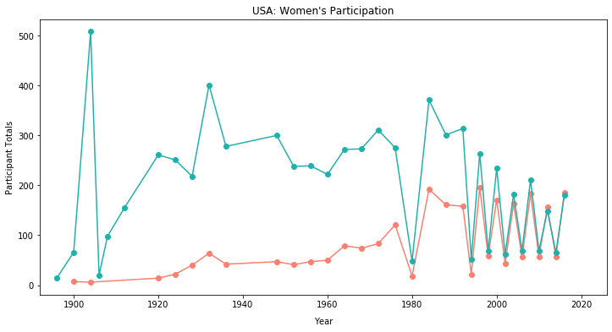
World Participation
China
Russia
Japan
USA

Slide 7
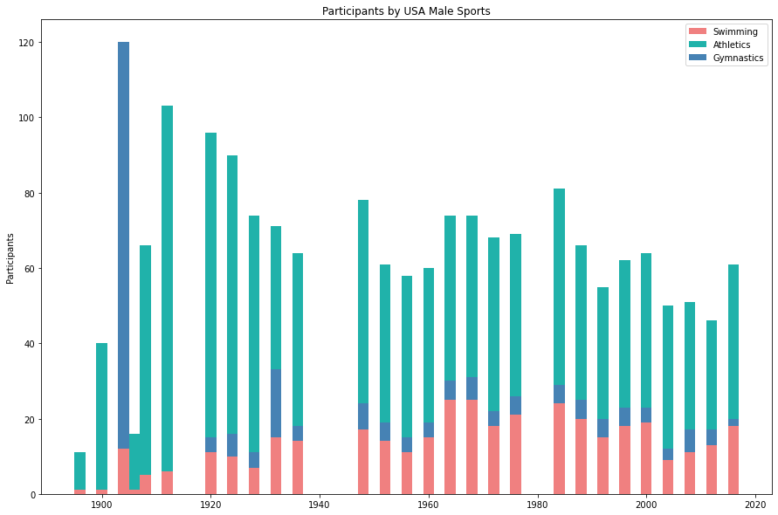
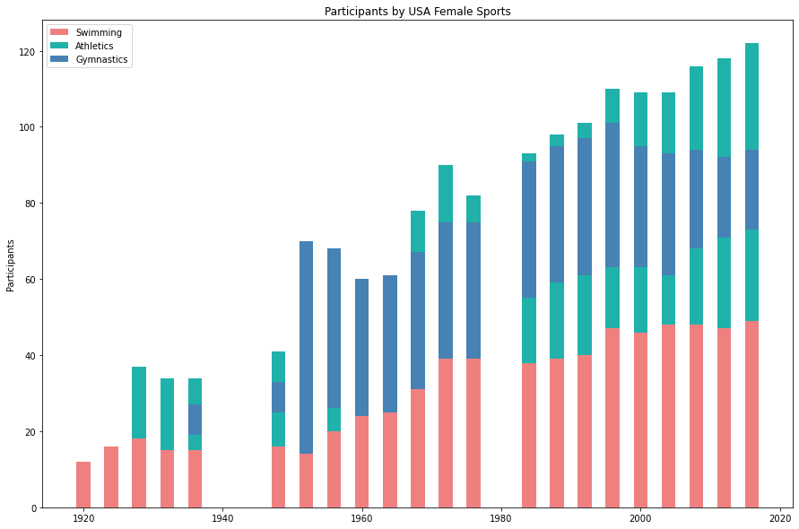
Participation by Sport

Slide 8
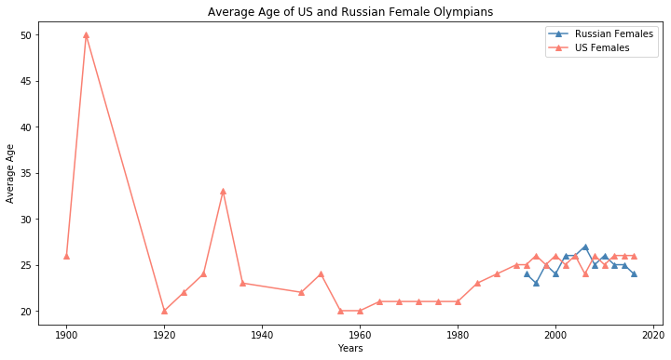
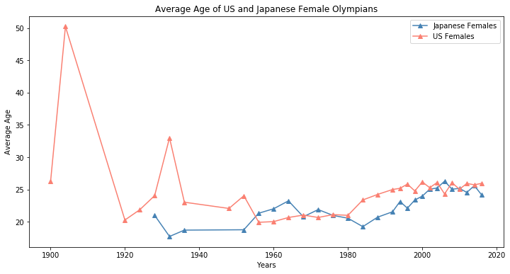
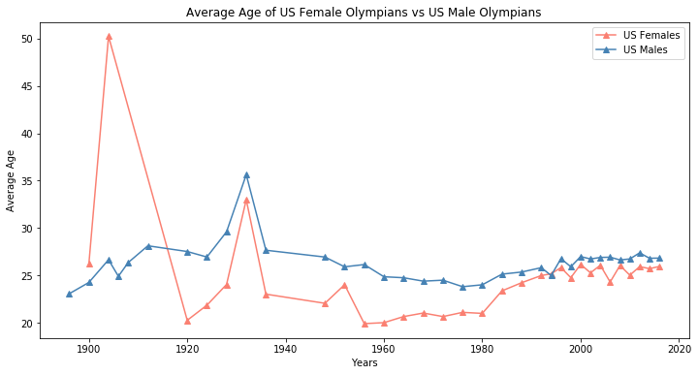
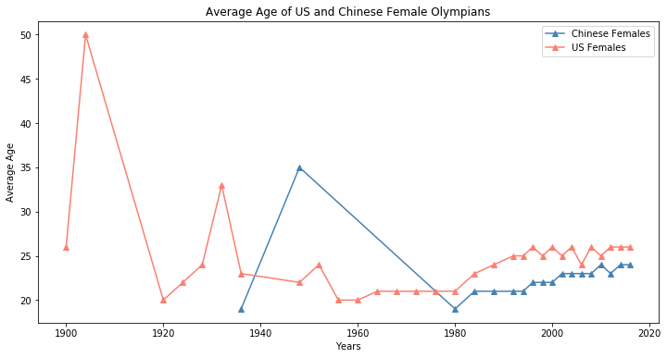
Age Analysis

Slide 9
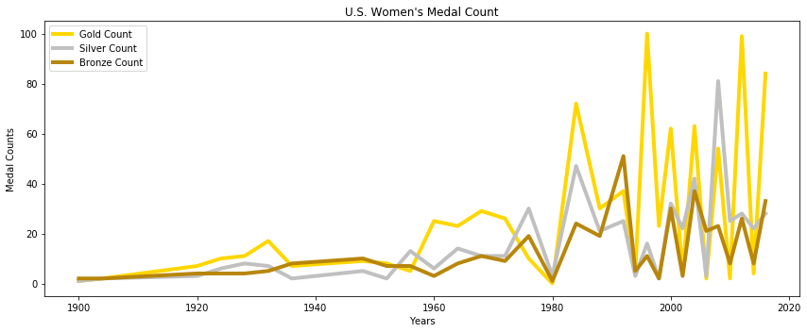
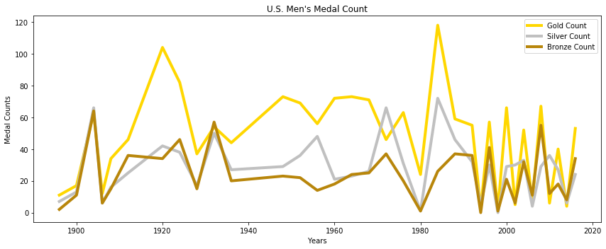
U.S. Medal Count

Slide 10
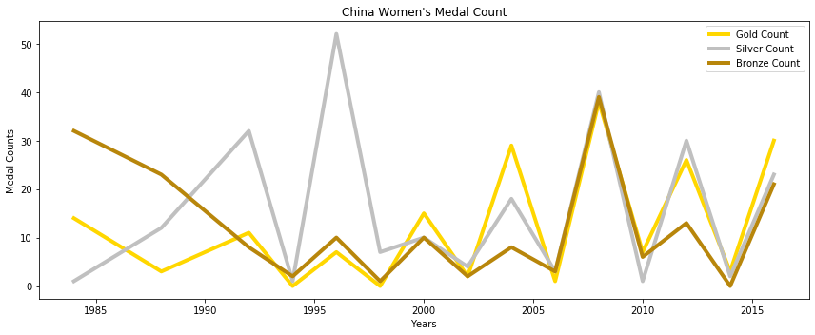
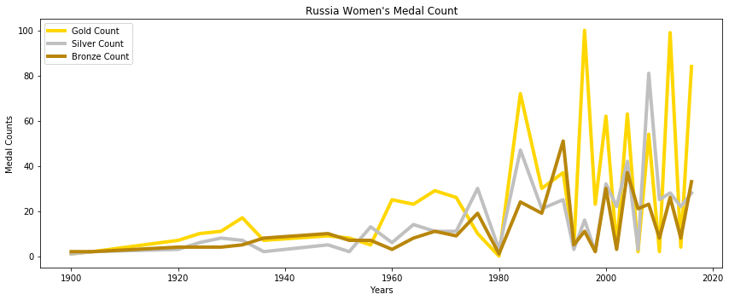
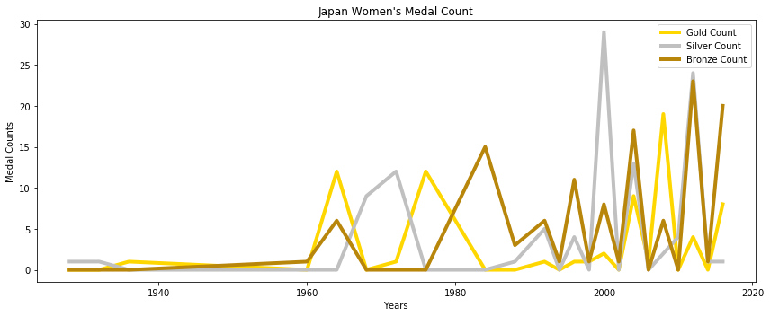
China
World Medal Count
Russia
Japan

Slide 11

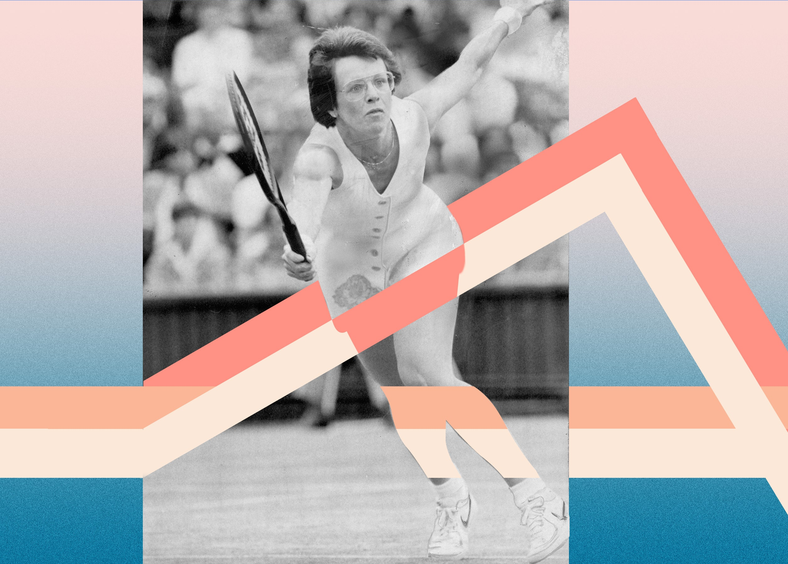
Conclusion
Historically, women are underpaid, undervalued, and overlooked at every turn. But they’re fighting back—and winning.

Slide 12
References
Data Source:
120 years of Olympic History: athletes and results
Additional Resources:
Peak Age for Olympic Athletes
The Forgotten History of Female Athletes Who Organized Their Own Olympics
Title VII of the Civil Rights Act of 1964
Winter Olympics: Women's Long Race to Parity
Gender disparties still vex Tokyo Olympic Games
Women Athletes in the Olympic Games
Women's Suffrage
5 Facts about Women's Rights in Russia
When Women Around the World got the Right to Vote
A Woman's Happiness is in the Home.. Huh?
Introduction of Female Suffrage
The Fight for Women's Rights in China

